Slide 1
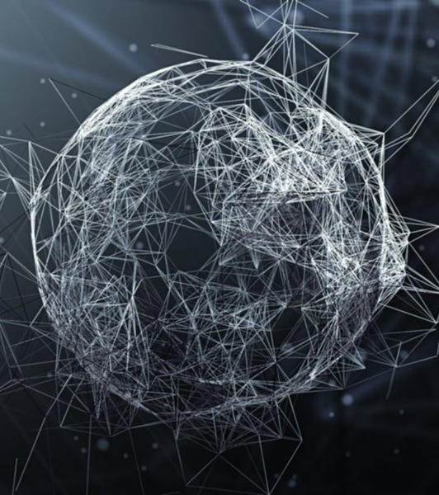
Graph Attention Network (GAT)
Petar Veličković, Guillem Cucurull, Arantxa Casanova, Adriana Romero, Pietro Liò, Yoshua Bengio
https://arxiv.org/abs/1710.10903
https://github.com/PetarV-/GAT
Presentation by Parsa Abbasi
Iran University of Science and Technology
June, 2021
http://parsa-abbasi.ir
https://github.com/parsa-abbasi/GAT

Slide 2
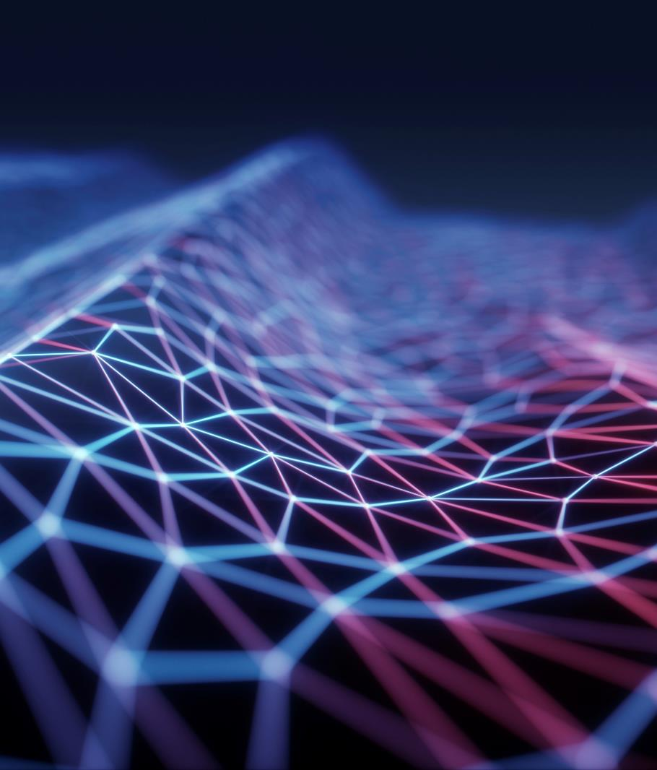
Graph Neural Networks (GNNs)
Many interesting tasks involve data that can not be represented in a grid-like structure and that instead lies in an irregular domain.
This is the case of 3D meshes, social networks, telecommunication networks, biological networks or brain connectomes.
Such data can usually be represented in the form of graphs.

Slide 3
Motivations
Attention mechanisms
A de facto standard in many sequence-based tasks
They allow for dealing with variable sized inputs
And focusing on the most relevant parts of the input to make decisions.
When an attention mechanism is used to compute a representation of a single sequence, it is commonly referred to as self-attention or intra-attention.
The attention architecture has several interesting properties:
The operation is efficient, since it is parallelizable across node neighbor pairs.
It can be applied to graph nodes having different degrees by specifying arbitrary weights to the neighbors.
The model is directly applicable to inductive learning problems, including tasks where the model has to generalize to completely unseen graphs.

Slide 4

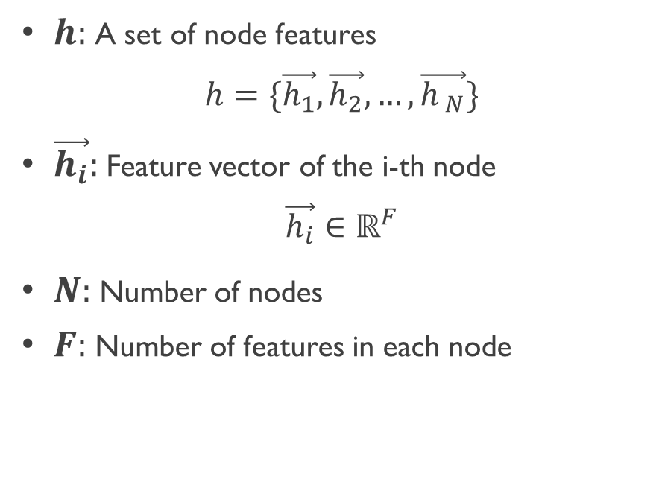





Layer Architecture
$$F$$
Inputs
$h:$A set of node features
$$h=\{\vec{h_{1}},\vec{h_{2}},…,\vec{h_{ N}}\}$$
$\vec{h_{i}}:$Feature vector of the i-th node
$$\vec{h_{i}}∈ℝ^{F}$$
$N:$Number of nodes
$F:$Number of features in each node
2
$$h_{2}$$
1
4
$$h_{1}$$
$$h_{4}$$
3
5
$$h_{3}$$
$$h_{5}$$

Slide 5
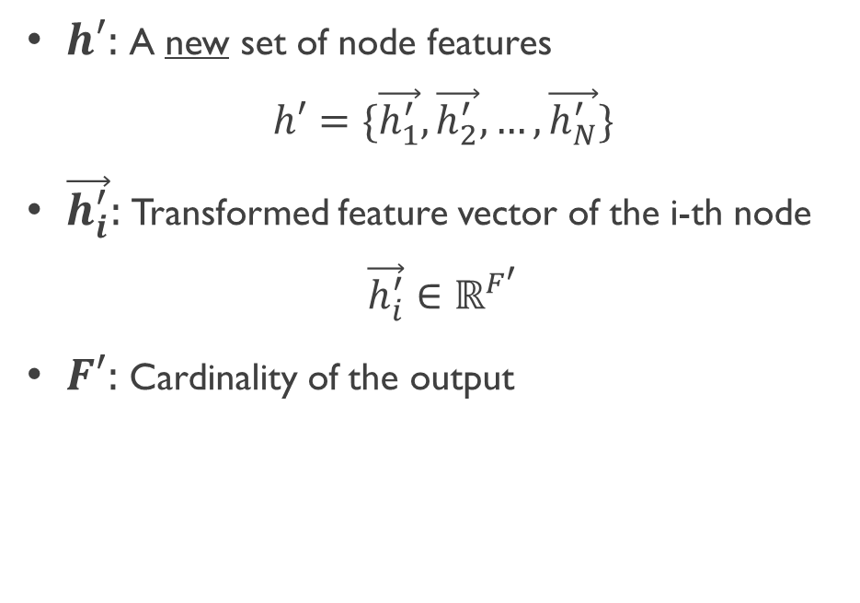


Layer Architecture
GAT Layer
$$F^{′}$$
Output
$h′:$A new set of node features
$$h′=\{\vec{h_{1}^{′}},\vec{h_{2}^{′}},…,\vec{h_{N}^{′}}\}$$
$\vec{h_{i}^{′}}:$Transformed feature vector of the i-th node
$$\vec{h_{i}^{′}}∈ℝ^{F^{′}}$$
$F′:$Cardinality of the output
2
$$h_{2}$$
$$h_{2}^{′}$$
1
4
3
5

Slide 6
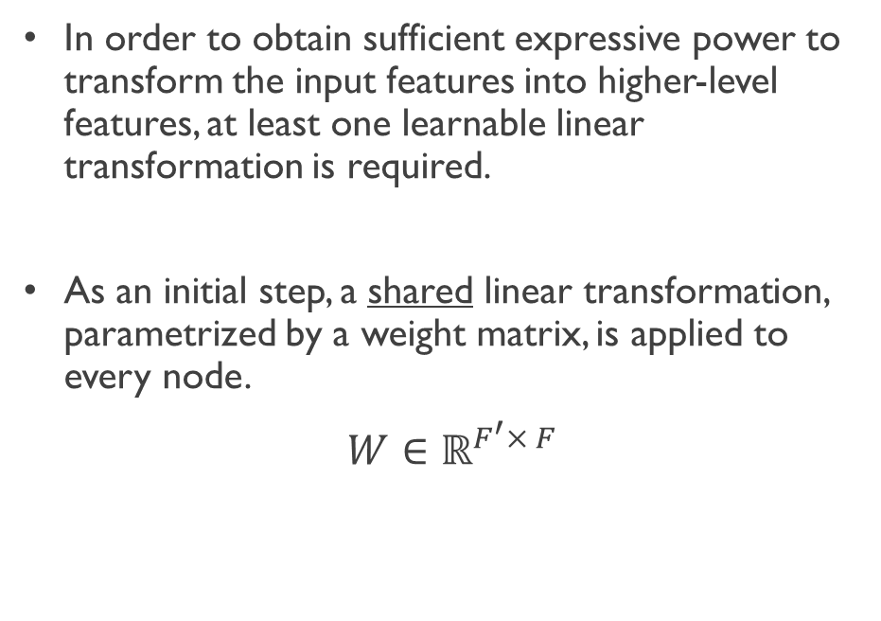



Layer Architecture
$$F^{′}$$
$$F$$
Initial step
In order to obtain sufficient expressive power to transform the input features into higher-level features, at least one learnable linear transformation is required.
As an initial step, a shared linear transformation, parametrized by a weight matrix, is applied to every node.
$$W∈ℝ^{F^{′}× F}$$
2
$$h_{2}$$
$$W$$
1
4
3
5

Slide 7
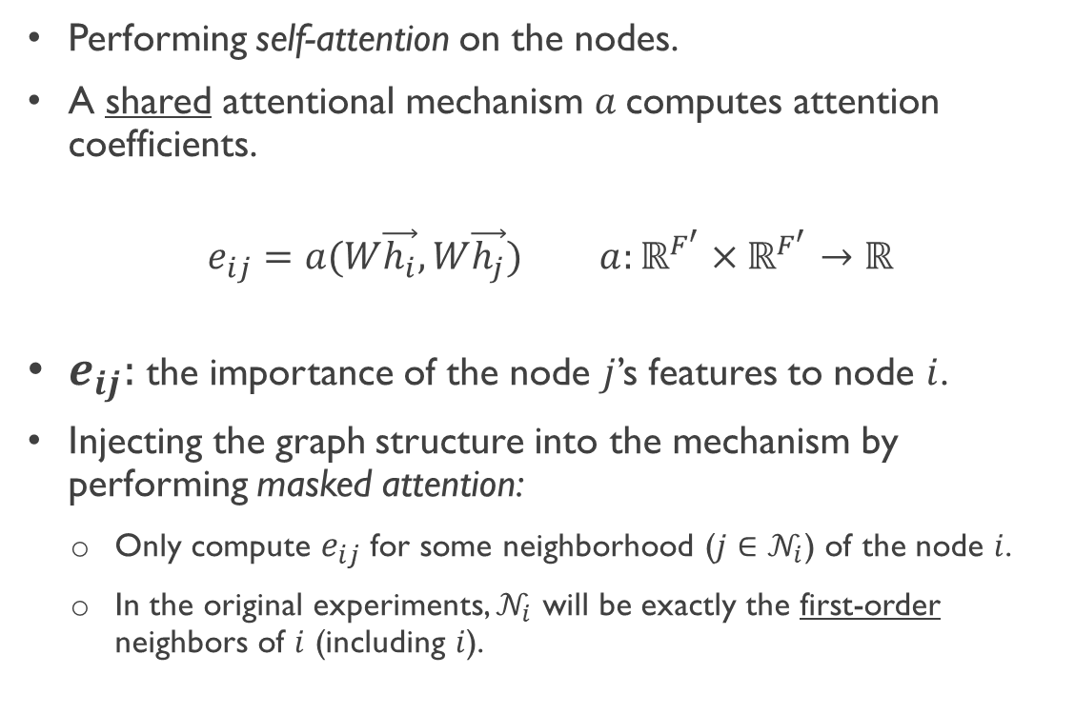

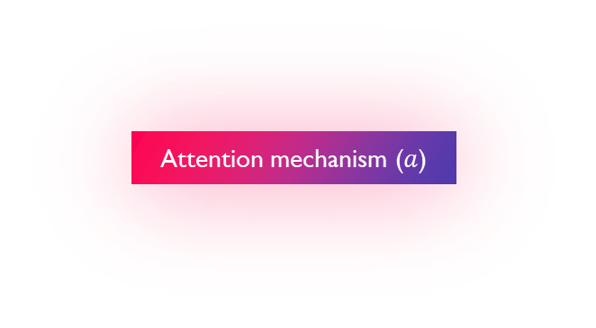


Layer Architecture
Attention
Performing self-attention on the nodes.
A shared attentional mechanism $a$computes attention coefficients.
$e_{ij}=a(W\vec{h_{i}},W\vec{h_{j}})$ $a:ℝ^{F^{′}}×ℝ^{F^{′}}→ℝ$
$e_{ij}:$the importance of the node $j$’s features to node $i$.
Injecting the graph structure into the mechanism by performing masked attention:
Only compute $e_{ij}$ for some neighborhood ($j∈𝒩_{i}$) of the node $i$.
In the original experiments, $𝒩_{i}$ will be exactly the first-order neighbors of $i$ (including $i$).
$$e_{ij}$$
Attention mechanism ($a$)
$$W\vec{h_{i}}$$
$$W\vec{h_{j}}$$

Slide 8
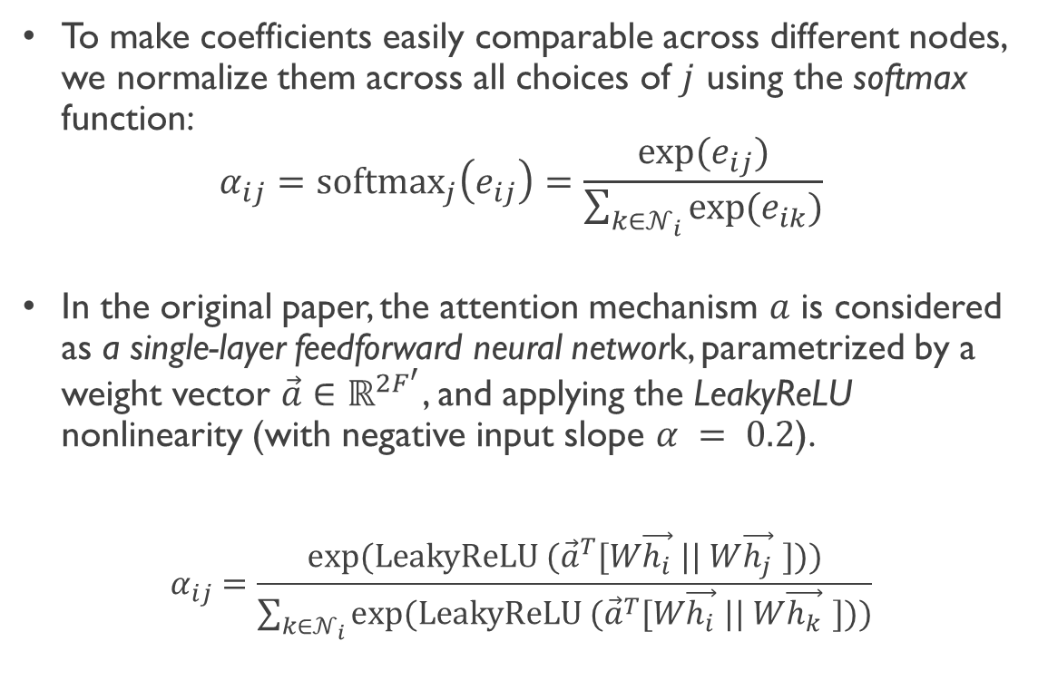




Layer Architecture
Attention
To make coefficients easily comparable across different nodes, we normalize them across all choices of $j$ using the softmax function:
$$α_{ij}={softmax}_{j}\left(e_{ij}\right)=\frac{exp⁡(e_{ij})}{\sum_{k∈𝒩_{i}}{{exp⁡(e}_{ik})}}$$
In the original paper, the attention mechanism $a$ is considered as a single-layer feedforward neural network, parametrized by a weight vector $\vec{a}∈ℝ^{2F^{′}}$, and applying the LeakyReLU nonlinearity (with negative input slope $α = 0.2$).
$$α_{ij}=\frac{exp⁡(LeakyReLU ({\vec{a}}^{T}[W\vec{h_{i}} || W\vec{h_{j}} ]))}{\sum_{k∈𝒩_{i}}{exp⁡(LeakyReLU ({\vec{a}}^{T}[W\vec{h_{i}} || W\vec{h_{k}} ]))}}$$
$$α_{ij}$$
$${softmax}_{j}$$
Leaky ReLU
$$W\vec{h_{i}}$$
$$W\vec{h_{j}}$$

Slide 9
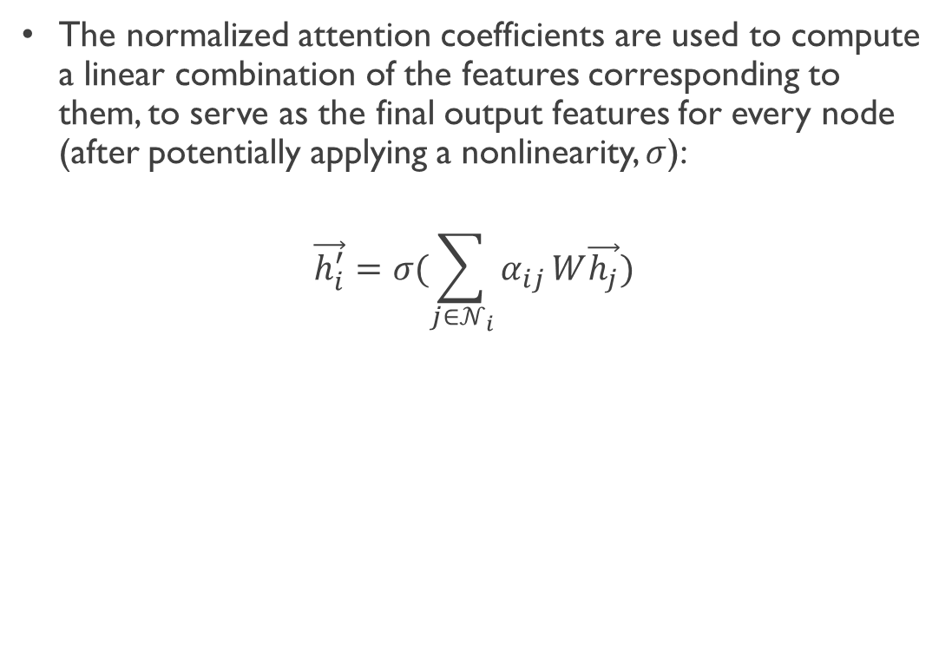



Layer Architecture
Final output features
The normalized attention coefficients are used to compute a linear combination of the features corresponding to them, to serve as the final output features for every node (after potentially applying a nonlinearity, $σ$):
$$\vec{h_{i}^{′}}=σ(\sum_{j∈𝒩_{i}}{α_{ij}}W\vec{h_{j}})$$
$$α_{12}$$
2
1
$$α_{15}$$
4
$$α_{13}$$
3
5

Slide 10
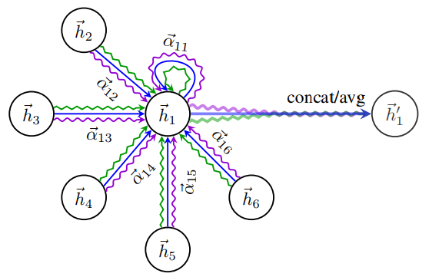
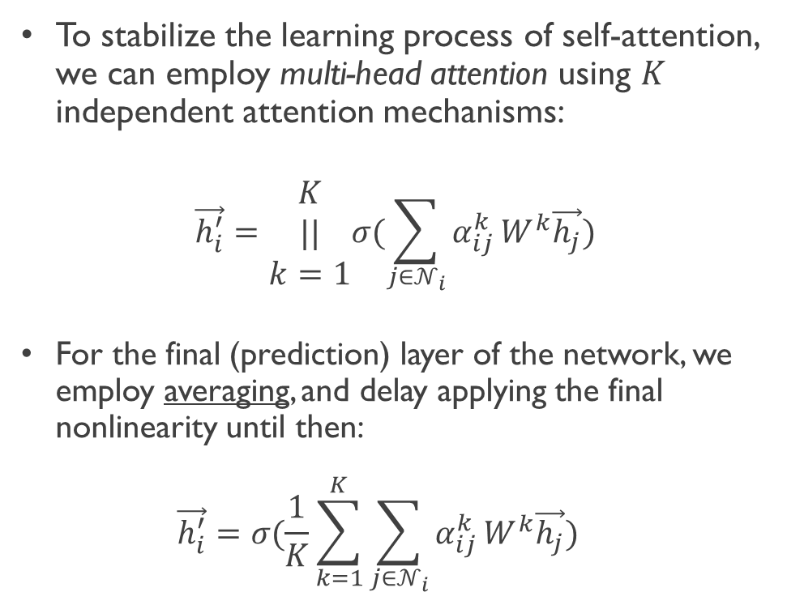
Layer Architecture
Multi-head attention
To stabilize the learning process of self-attention, we can employ multi-head attention using $K$ independent attention mechanisms:
$$\vec{h_{i}^{′}}=\begin{matrix}K \\ || \\ k=1\end{matrix}σ(\sum_{j∈𝒩_{i}}{α_{ij}^{k}}W^{k}\vec{h_{j}})$$
For the final (prediction) layer of the network, we employ averaging, and delay applying the final nonlinearity until then: $\vec{h_{i}^{′}}=σ(\frac{1}{K}\sum_{k=1}^{K}{\sum_{j∈𝒩_{i}}{α_{ij}^{k}}W^{k}\vec{h_{j}}})$

Slide 11
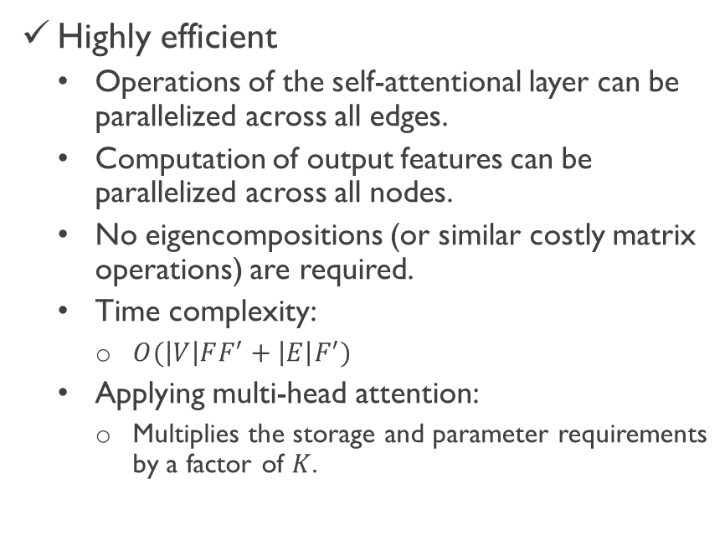
Advantages
Computationally
Learning capacity
Highly efficient
Operations of the self-attentional layer can be parallelized across all edges.
Computation of output features can be parallelized across all nodes.
No eigencompositions (or similar costly matrix operations) are required.
Time complexity:
$O(\left|V\right|FF^{′}+\left|E\right|F^{′})$
Applying multi-head attention:
Multiplies the storage and parameter requirements by a factor of $K$.
Enabling a leap
(Implicitly) assigning different importances to nodes of a same neighborhood (In contrast to GCNs).
Benefits in interpretability:
By analyzing the learned attentional weights.

Slide 12
Advantages
Structure dependency
Neighborhood considerations
Doesn’t depend on upfront access
Because the attention mechanism is applied in a shared manner to all edges.
Bring several desirable implications:
Graph is not required to be undirected.
Directly applicable to inductive learning.
Entire neighborhood
Sampleing a fixed-size neighborhood of each node:
Does not allow it access to the entirety of the neighborhood while performing inference.
Using a LSTM-based neighborhood aggregator:
Assumes the existence of a consistent sequential node ordering across neighborhoods.
GAT does not suffer from either of these issues:
Works with the entirety of the neighborhood.
Does not assume any ordering within it.

Slide 13
Disadvantages
Batching capabilities
GPU benefits
Limited
The tensor manipulation framework we used only supports sparse matrix multiplication for rank-2 tensors.
Especially for datasets with multiple graphs.
Minor
Depending on the regularity of the graph structure in place, GPUs may not be able to offer major performance benefits compared to CPUs in these sparse scenarios.
Size of the “receptive field”
Parallelization (across all the graph edges)
Upper-bounded by the depth of the network
Similarly as for GCN and similar models.
Techniques such as skip connections could be readily applied for appropriately extending the depth, however.
May involve a lot of redundant computation
As the neighborhoods will often highly overlap in graphs of interest.

Slide 14
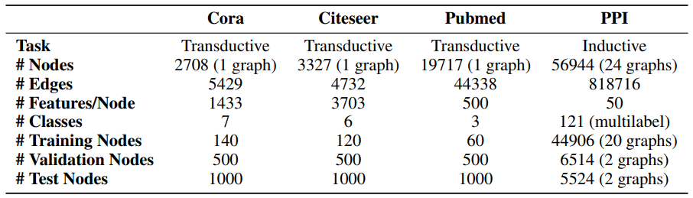
Datasets
Transductive:
Assumes that all nodes in the graph are present during training [1].
Inductive:
Including tasks where the model is evaluated on graphs that are completely unseen during training.

Slide 15
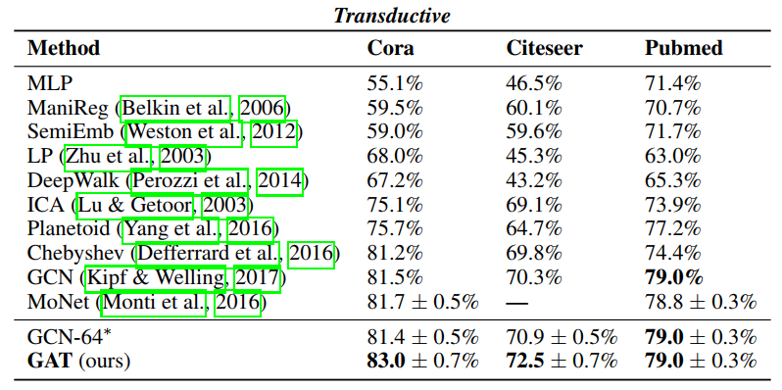
Results
Transductive

Slide 16
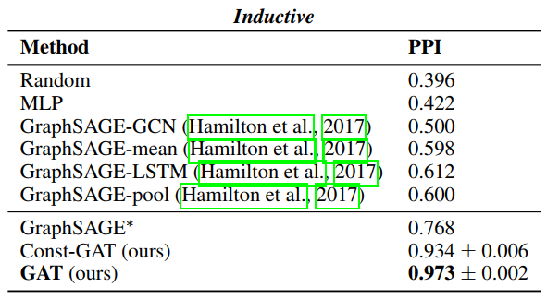
Results
Inductive

Slide 17
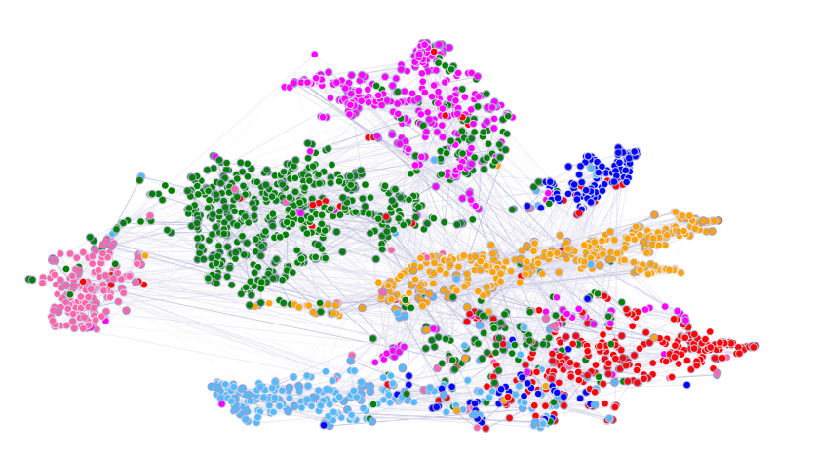
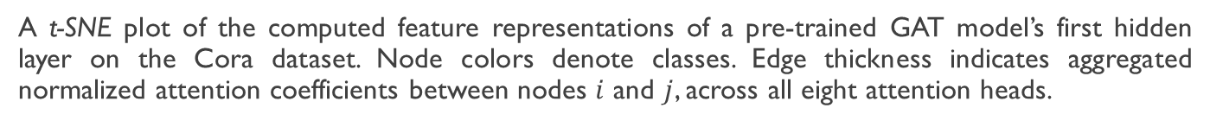
Visualization
A t-SNE plot of the computed feature representations of a pre-trained GAT model’s first hidden layer on the Cora dataset. Node colors denote classes. Edge thickness indicates aggregated normalized attention coefficients between nodes $i$ and $j$, across all eight attention heads.

Slide 18



Thank You
Some helpful contents to learn more about the GATs:
Understanding Graph Attention Networks by DeepFindr
Graph Attention Networks (GAT) | GNN Paper Explained
by The AI Epiphany
Graph Attention Network Project Walkthrough by The AI Epiphany
GAT - Graph Attention Network (PyTorch) by Aleksa Gordic
Graph Attention Networks Under the Hood by Giuseppe Futia

